Slide 1
Image Generation using Deep Convolutional -GAN
NAME: Priya A
NM-ID:au711721243071
KGiSL Institute Of Technology
3/21/2024 Annual Review

Slide 2
PROJECT TITLE
Generate Images using Deep Convolutional -GAN
3/21/2024 Annual Review

Slide 3


AGENDA
Problem Statement.
Project Overview.
End Users.
Our Solution and Proposition.
Key Features.
Modelling Approach
Results and Evaluation
3/21/2024 Annual Review

Slide 4

PROBLEM STATEMENT
Develop a Deep Convolutional Generative Adversarial Networks (DC-GANs) to generate high-quality images that closely resemble those in the training dataset.
3/21/2024 Annual Review

Slide 5

PROJECT OVERVIEW
Implement a DC-GANs, a type of neural network, to create realistic images from a dataset.
This approach involves training a computer system using a combination of two neural networks: a generator and a discriminator.
The generator learns to produce images from scratch, while the discriminator learns to differentiate between real images from the dataset and the synthetic ones created by the generator.
Through training, these networks improve and produce better images over time. Selecting a dataset and preparing it for training. Then, designing the network architecture and training it to generate images.
During training, the generator and discriminator compete to improve.
The Model is adjusted as needed to get the best results. Finally , the images are evaluated for realism and diversity.
3/21/2024 Annual Review

Slide 6

WHO ARE THE END USERS?
The end users of the Generating Images with Deep Convolutional Generative Adversarial Networks (DC-GANs) could include:
Artists and Designers: They can use the generated images as inspiration or as components in their creative projects.
Entertainment Industry Professionals: Such as filmmakers, game developers, and animators who may use the generated images for characters, backgrounds, or scenes in movies, video games, or animations.
Advertising Agencies: They can utilize the generated images for creating visually appealing advertisements or promotional materials.
Architects and Urban Planners: Utilizing generated images for visualizing architectural designs or urban landscapes.
3/21/2024 Annual Review

Slide 7

YOUR SOLUTION AND ITS VALUE PROPOSITION
SOLUTION: Our solution utilizes DC-GANs to generate lifelike images closely resembling those in a given dataset. Through iterative training, our system learns to produce realistic images indistinguishable from real ones.
VALUE PROPOSITION:
Our solution offers a compelling value proposition by leveraging AI-driven image generation to produce lifelike images suitable for diverse applications such as art, design, and entertainment. With streamlined efficiency and automation, we save time and resources in visual creation. Our versatile approach spans various image types and scenarios, driving innovation and contributing to advancements in AI technology.
3/21/2024 Annual Review

Slide 8

THE WOW IN YOUR SOLUTION
Our solution excels in generating highly realistic images, powered by advanced AI automation for efficient and top-quality results. Whether it's human faces or landscapes, our versatile approach caters to diverse needs. What truly distinguishes us is our commitment to innovation, constantly pushing the boundaries of image generation technology. With customization at our core, we offer tailored solutions to meet the unique requirements of any user or industry. Witness the impressive capabilities of our solution and join us in shaping the future of image generation.
3/21/2024 Annual Review

Slide 9
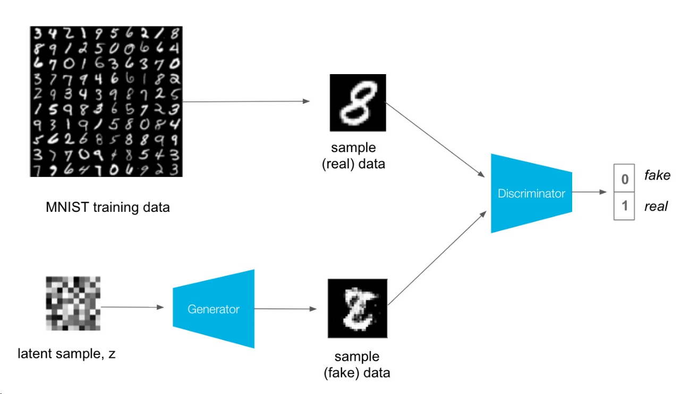
MODELLING
GENERATOR MODEL: Used to fake images resembling digits.
DISCRIMINATOR MODEL: Used to distinguish real and fake images.

Slide 10
RESULTS
Our project showcases the impressive capabilities of using DC-GANs to generate high-quality images. Through extensive training, our model closely replicates the training dataset, capturing fine details with fidelity. Its versatility spans diverse image types, from faces to landscapes, adapting to various scenarios. Our innovative use of DC-GANs advances image generation technology, contributing to AI progress.
Demolink

